Slide 1
Installation Guide
(Eclipse Plug-in － Subversive)
2009. 02. 19
CODELABOR
Shin Sang Jae (codelabor@gmail.com)

Slide 2
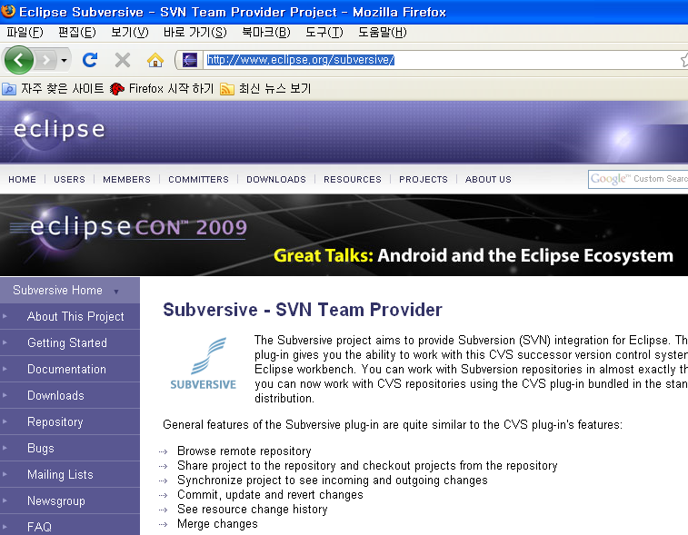
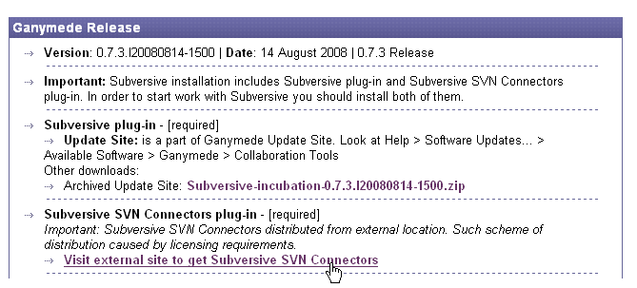
Eclipse Plug-in
Update
Eclipse Team Provider plug-in providing support for Subversion within the Eclipse IDE
Officical Site: http://www.eclipse.org/subversive/

Slide 3
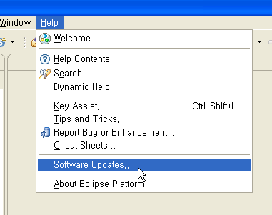
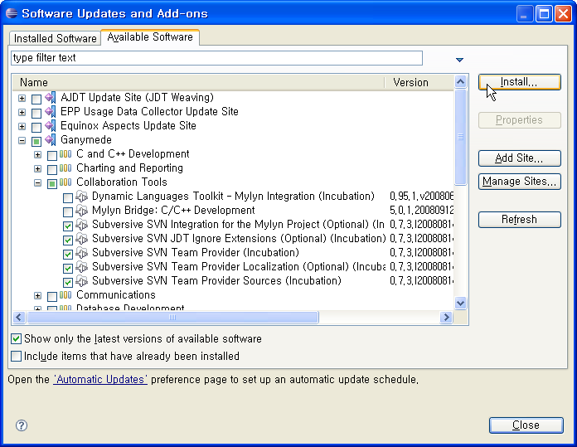
Eclipse Plug-in
Update
Eclipse > Help > Software Updates... > Available Software > Ganymede > Collaboration Tools
Check Subversive

Slide 4
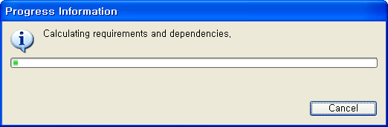
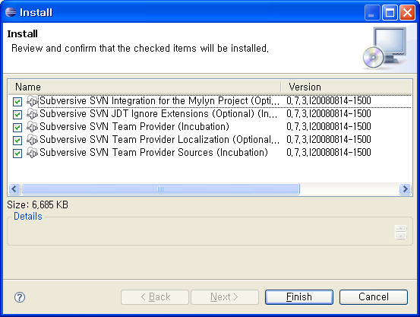
Eclipse Plug-in
Update
Install Subversive

Slide 5
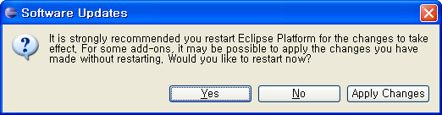
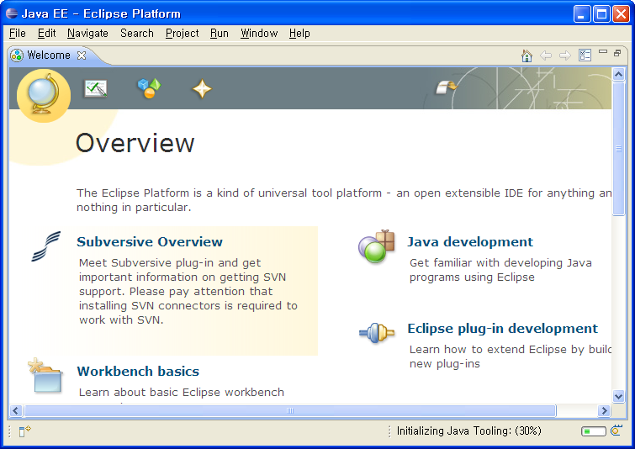
Eclipse Plug-in
Update
Restart eclipse

Slide 6
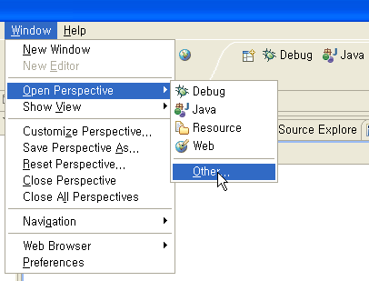
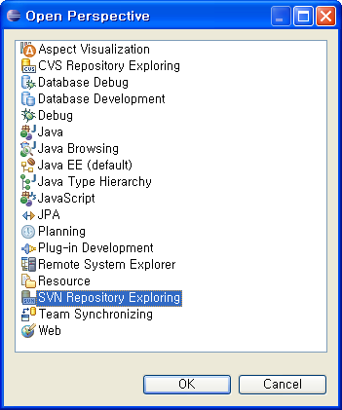
Eclipse Plug-in
Configuration
Change Perspective

Slide 7
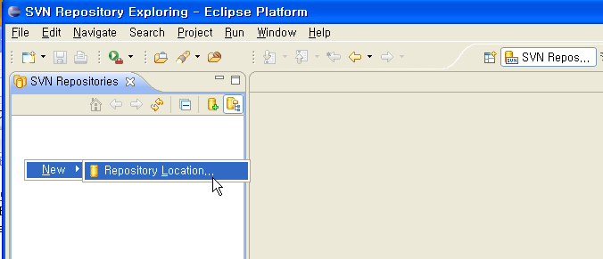
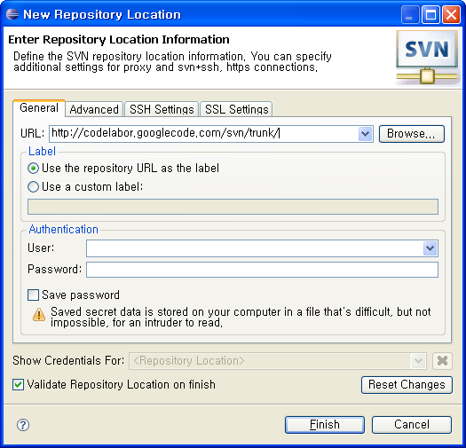
Eclipse Plug-in
Configuration
Set repository location
Repository URL: http://codelabor.googlecode.com/svn/trunk/

Slide 8
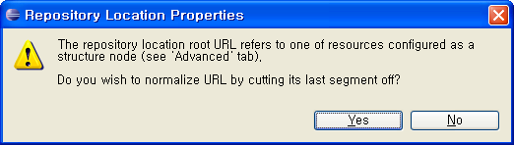
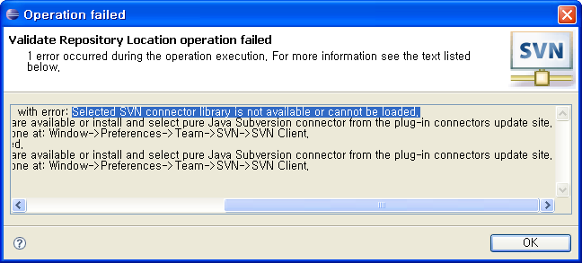
Eclipse Plug-in
Configuration
Normalize URL
Validate failed

Slide 9
Eclipse Plug-in
Configuration
Normalize URL
Validate failed

Slide 10
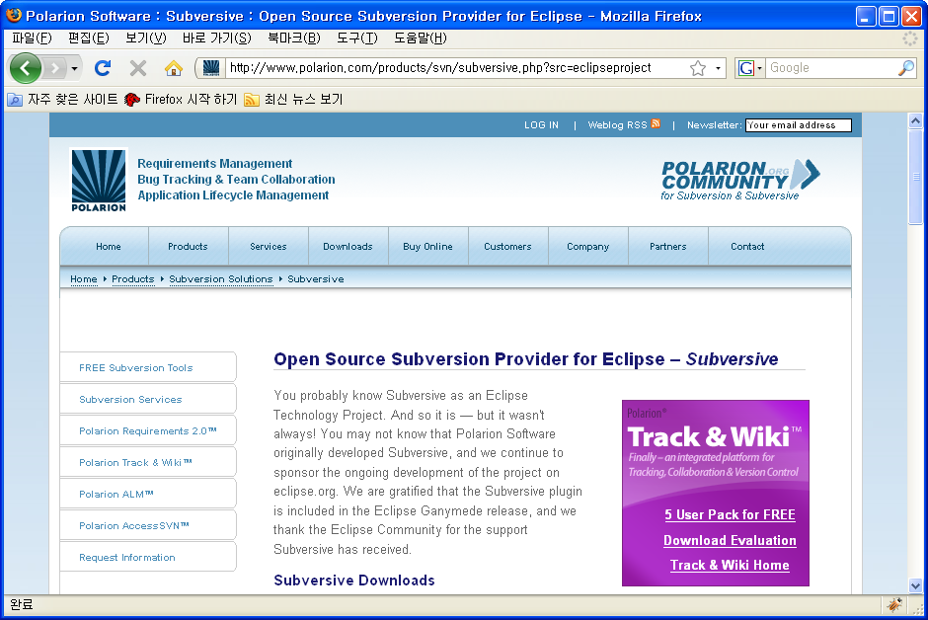
Eclipse Plug-in
Update
Subversive SVN Connectors plug-in
Officical Site: http://www.eclipse.org/subversive/

Slide 11
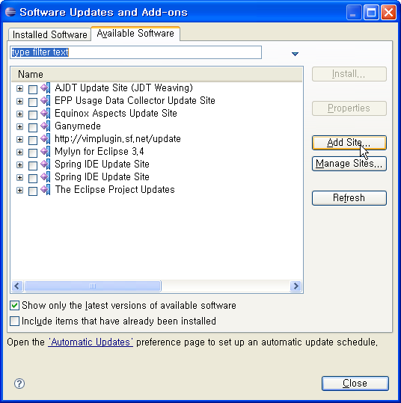
Eclipse Plug-in
Update
Update Site: http://www.polarion.org/projects/subversive/download/eclipse/2.0/update-site/

Slide 12
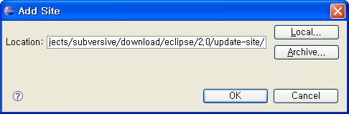
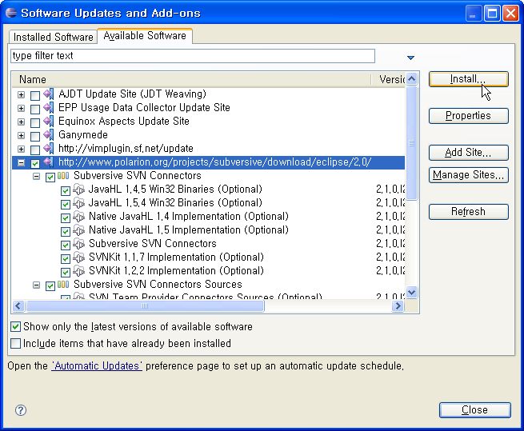
Eclipse Plug-in
Update
Add Site: http://www.polarion.org/projects/subversive/download/eclipse/2.0/update-site/
Check subversive SVN connector
Install

Slide 13
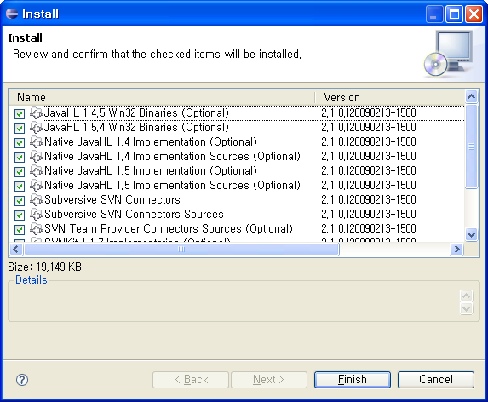
Eclipse Plug-in
Update
Install SVN connector
Restart eclipse

Slide 14
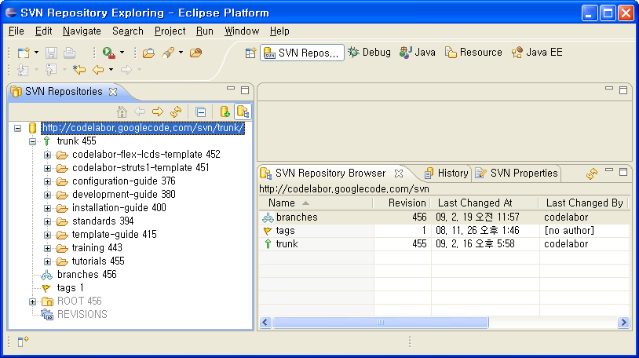
Eclipse Plug-in
Update
Refresh SVN Repository

